Slide 1
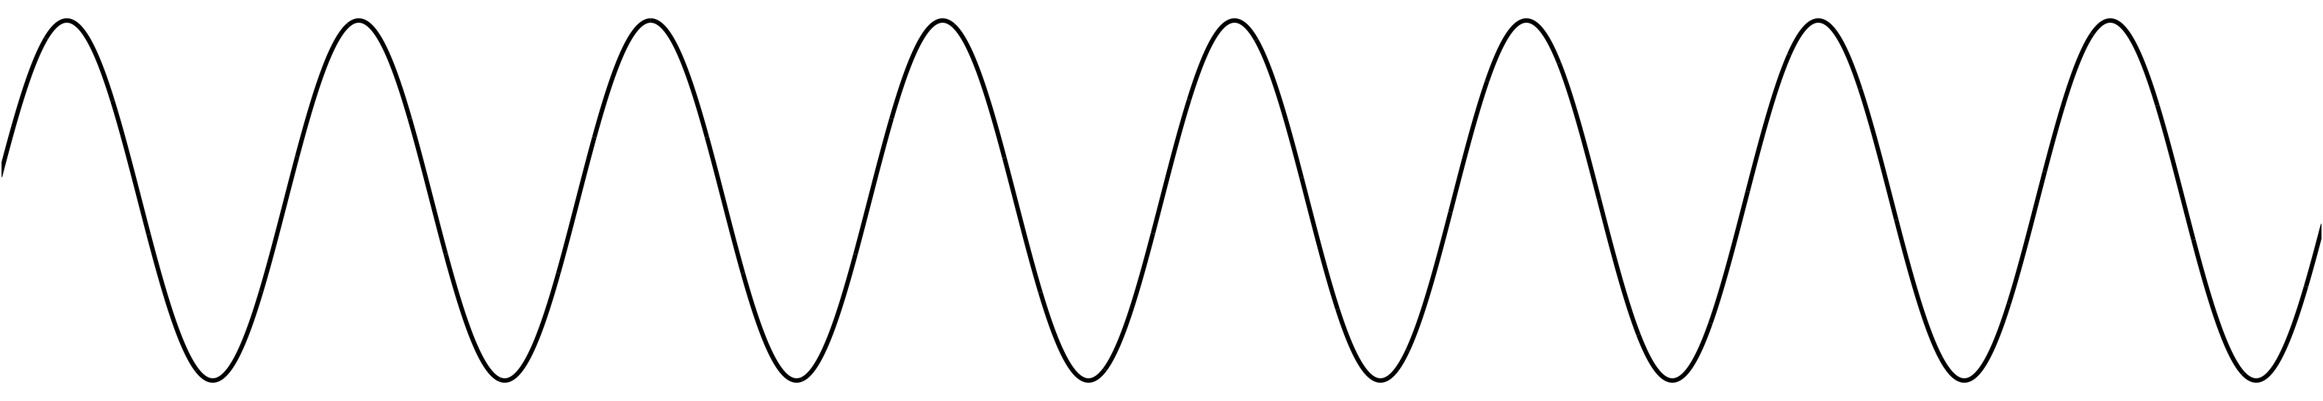
FFT of sine wave
Suppose its frequency exactly matches a bin: 2πk/N for some k
So integer number of oscillations in window
...
x[n]
All energy in one frequency bin
All other bins 0 (except mirror image above Nyquist)
Constant magnitude no matter where window starts
Phase may change depending on window location
Xk
(lower half)

Slide 2
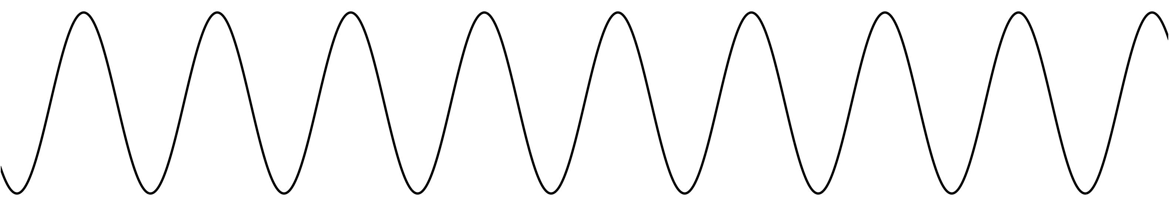
FFT of sine wave
If frequency doesn’t exactly match any bin
Energy smears out across all other frequency bins
Phase likely to be different on each successive hop
Usually, can reconstruct exact frequency based on phase changes!
x[n]
Non-integer number
of periods
Xk
Energy spills over into
other bins, especially close neighbours
(lower half)

Slide 3

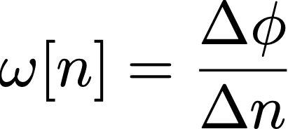
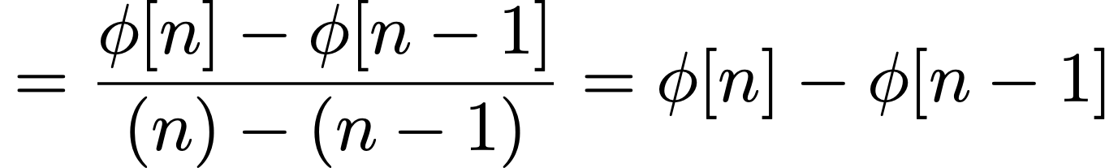
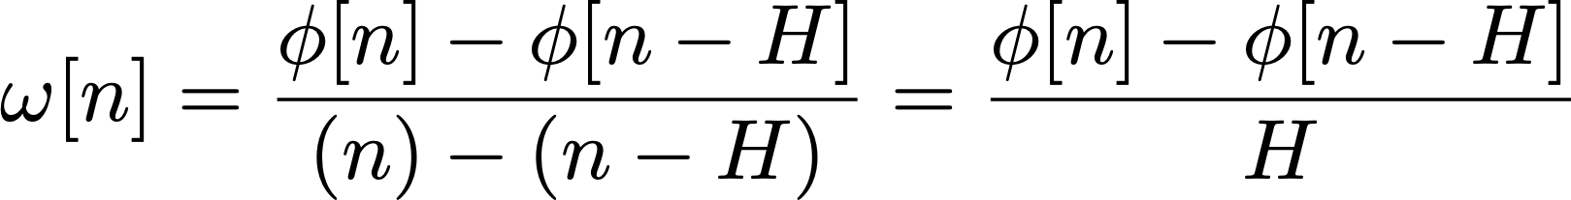
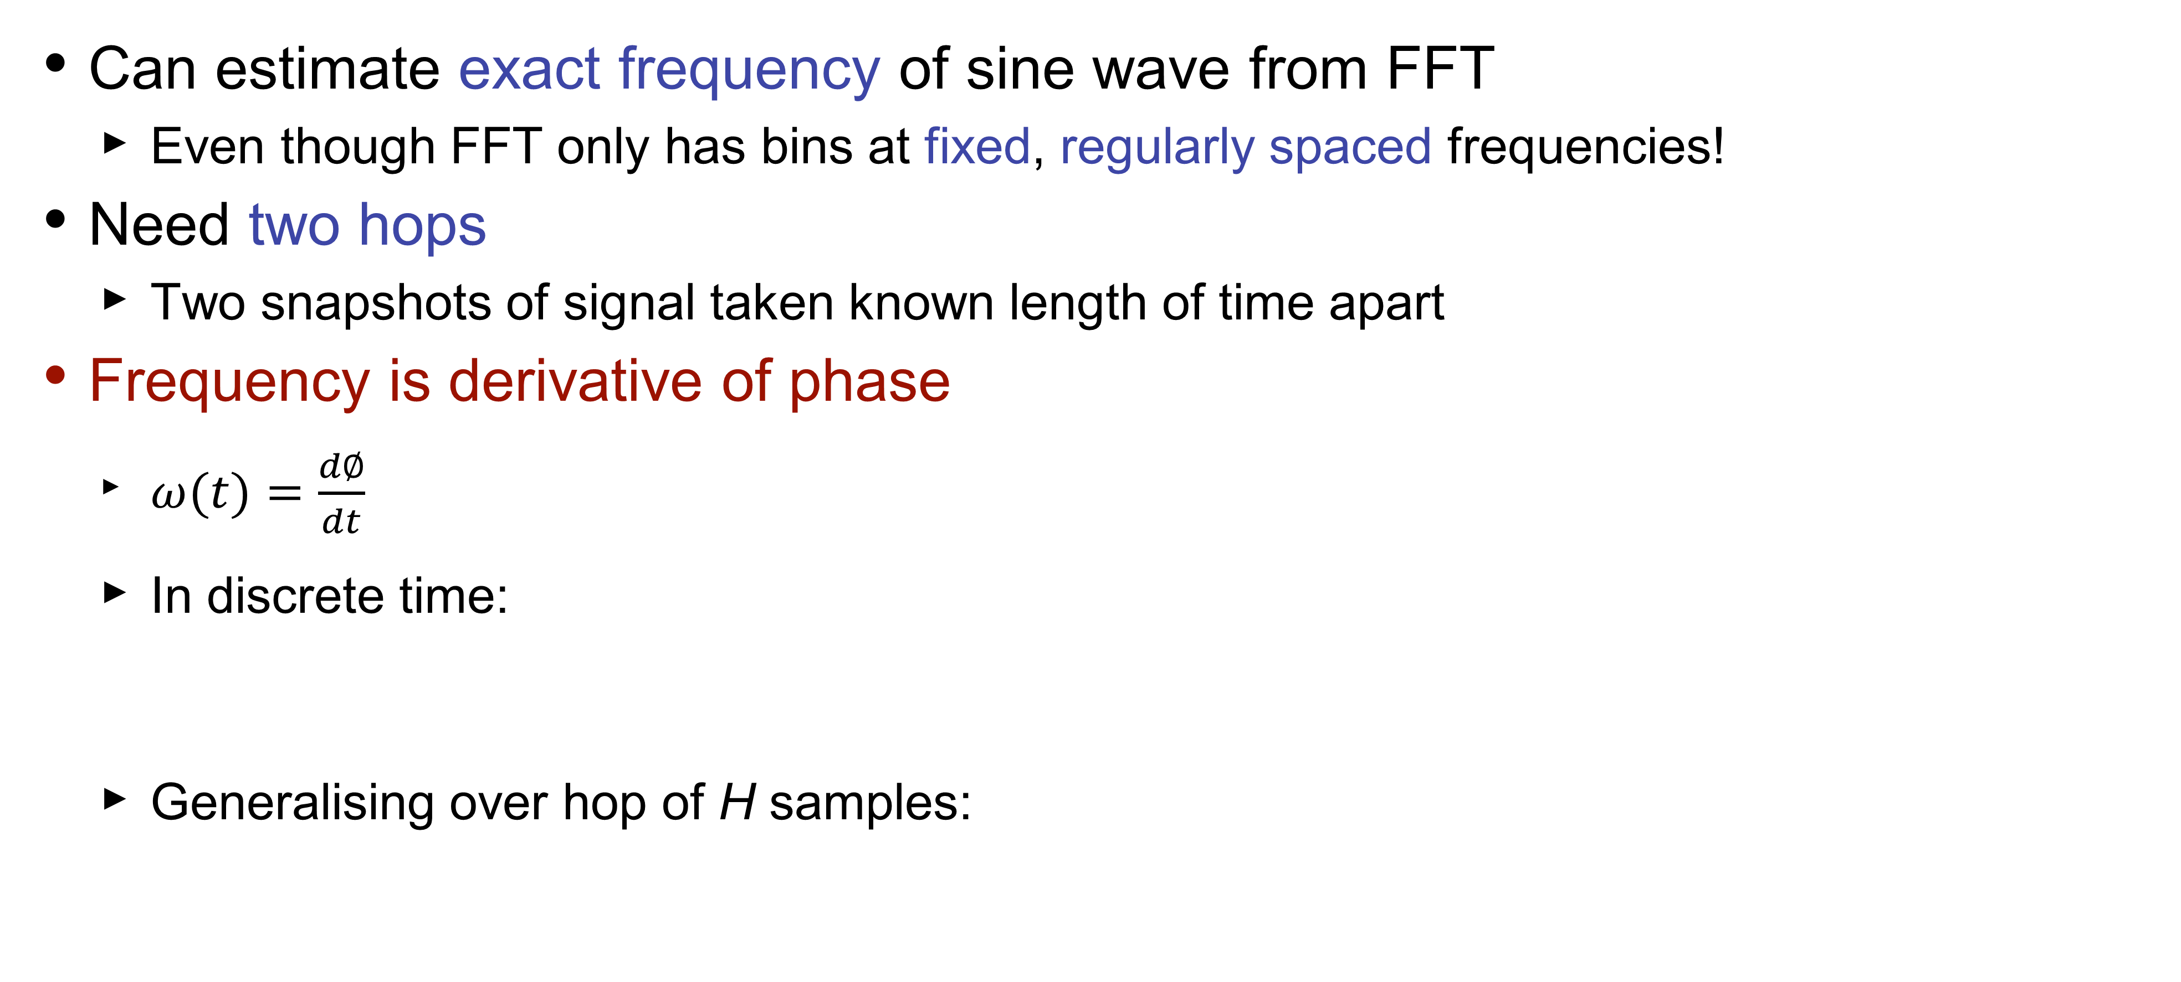
Reconstructing exact frequency
Can estimate exact frequency of sine wave from FFT
Even though FFT only has bins at fixed, regularly spaced frequencies!
Need two hops
Two snapshots of signal taken known length of time apart
Frequency is derivative of phase
$ω(t)=\frac{d∅}{dt}$
In discrete time:
Generalising over hop of H samples:
y

Slide 4
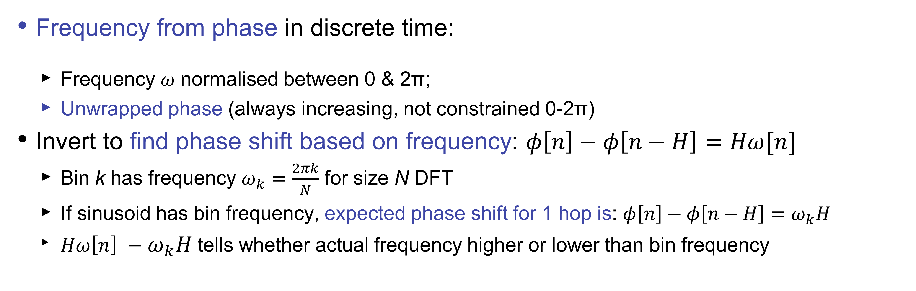
Reconstructing exact frequency
Frequency from phase in discrete time:
Frequency 𝜔 normalised between 0 & 2π;
Unwrapped phase (always increasing, not constrained 0-2π)
Invert to find phase shift based on frequency: $φ\left[n\right]−φ\left[n−H\right]=Hω[n]$
Bin k has frequency $ω_{k}=\frac{2πk}{N}$ for size N DFT
If sinusoid has bin frequency, expected phase shift for 1 hop is: $φ\left[n\right]−φ\left[n−H\right]=ω_{k}H$
${Hω\left[n\right] −ω}_{k}H$tells whether actual frequency higher or lower than bin frequency
φ[n]
Instantaneous frequency represented by gradient of dashed line
Bin frequency is gradient of solid line.
Φ_{e} – expected phase
Φ_{r} –phase deviation
Phase
φ_{r}
φ_{e}[n]
ω_{k}H
φ[n-H]
k-1
Frequency bin
k

Slide 5
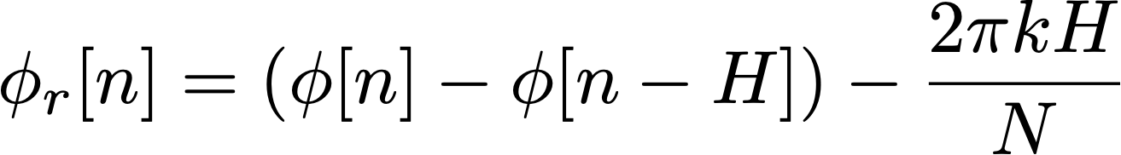
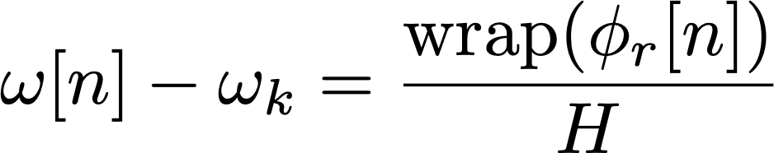
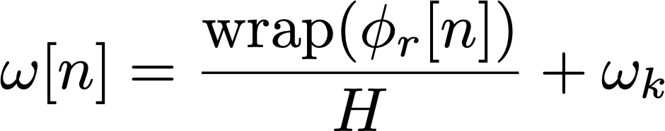
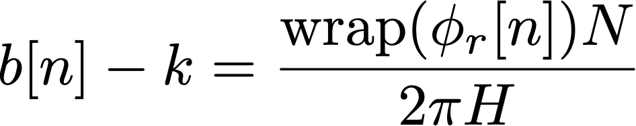
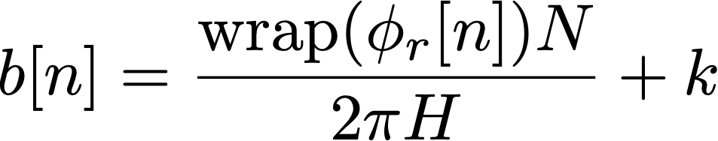
Reconstructing exact frequency
First calculate phase remainder:
Use remainder to calculate deviation from bin centre frequency:
Should wrap phase to be between -π and π (i.e. principal argument)
Finally, rearrange to get exact frequency of our sine wave:
Could also calculate in terms of (fractional) FFT bins
Use fact that bins are spaced 2π/N apart in frequency
measured phase values from bin k on two successive hops
centre frequency of bin k
multiplied by hop size
centre frequency of bin k (= 2πk/N)
fractional bin #
of sine wave

Slide 6
Reconstructing exact frequency: code
Predict how far phase ought to advance from one
hop to next, then compare actual measured values
Phase advancing farther means higher frequency (compared to bin frequency)
Phase advancing less far means lower frequency
What do we need to implement this in code?
Global (or static) variable to hold phase of each bin
Saving each bin implies an array
Similar to saving previous values of x[n] or y[n] for a filter
Function to wrap phase to range -π to π
Implement calculations inside our process_fft() function
Write for() loop iterating across each bin
y
prediction

Slide 7
Reconstructing exact frequency: task
Task: Write code to work out exact frequency of each bin
Implement these formulas:
You will need global or static array to hold previous phases
Same formula can apply to every bin regardless of magnitude
In practice, we only look at the first half of bins because the DFT is conjugate symmetric
hop size
bin phase this hop
bin phase last hop
FFT
size
bin
number
wrapPhase()
written for you
bin centre frequency
(2πk/N)

